Slide 1

Crime incidence IN WASHINGTON DC
DATS 6101 – PROJECT 1
GROUP NAME – CHERRY
GROUP MEMBERS – Zichu Chen, Zixuan Huang, RUTH AKOR, Qing Ruan, Kaiqi Yu

Slide 2
INTRODUCTION – why is this study important?
There has been recent media releases on mass shootings and other crimes around the US
Increased incidence of crime is a threat to public safety and welfare.
Between 2017 and 2018, homicide rates in DC increased by about 38%, followed by auto theft which increased by 13%. However, there was a slight decrease in other crimes such as sex abuse, assault and robbery.

Slide 3
DATA DESCRIPTION
Data Source: OpenDC
Time frame: 2018
Data type: Cross-sectional data for crime incidence in Metro DC
Number of observations: 33,783 crime incidence
Variables: date and time of crime incidence, weapon/method used, offense classification, location of crime, date of report and report ID

Slide 4
Characteristics of offenders
CRIME TYPES AND METHODS
Violent Crime
Homicide
Sexual Abuse
Property Crime
Burglary
Arson
Robbery
Theft
Assault
Auto theft

Slide 5
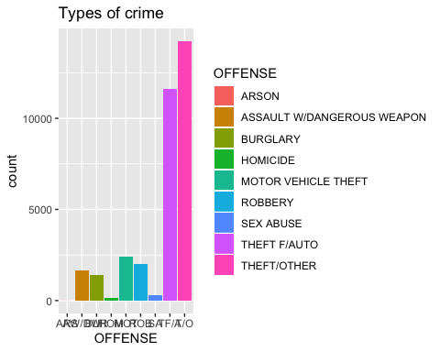
CRIME TYPES AND FREQUENCIES
The most common crime type in DC for 2018 was other forms of theft, followed by auto theft. Arson occurred the least

Slide 6
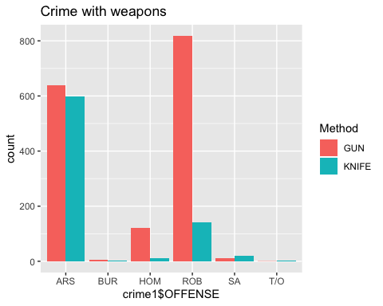
WHAT CRIMES ARE COMMITTED WITH WEAPONS ?
Of all the crimes in DC for 2018, 7.02% of the crimes were committed with weapons
Gun is the most used weapon and it used mostly for robbery and arson

Slide 7
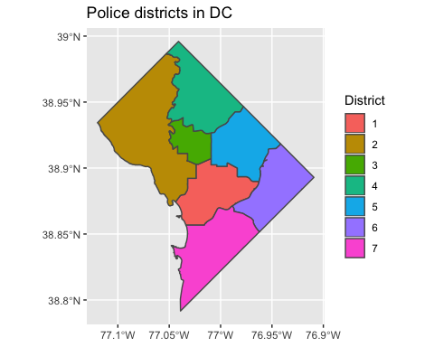
POLICE DISTRICTS IN DC

Slide 8
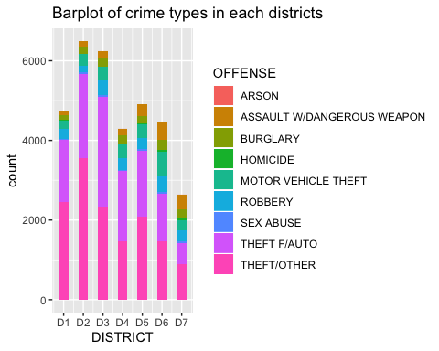
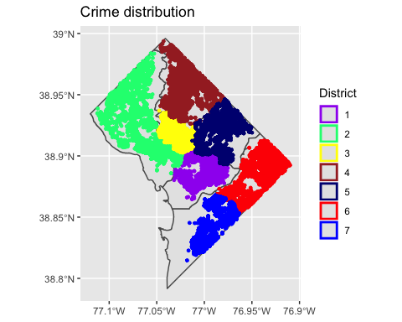
GEOGRAPHY OF CRIME ACROSS THE POLICE DISTRICTS
District 3 and 2 have the highest crime occurrence. District 7 has the least crime occurrence. Auto theft and other forms of theft are the most common forms of theft across all districts

Slide 9
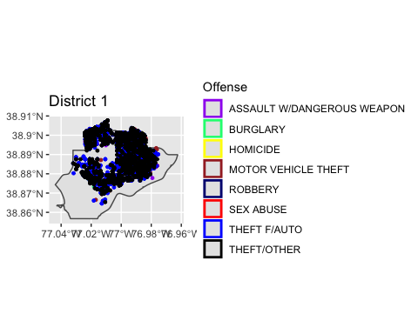
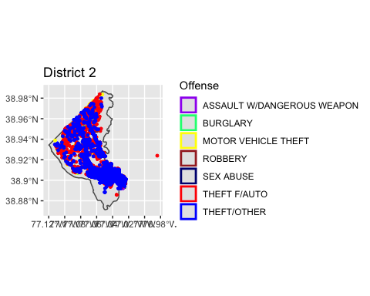
Crime incidence in each district
In District 1, most of the crimes happened in the north and central area.
Most of the crimes happened in the northwest and southeast area. However, no homicide occurred in District 2 compared to other districts.

Slide 10
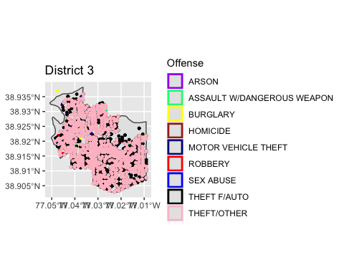
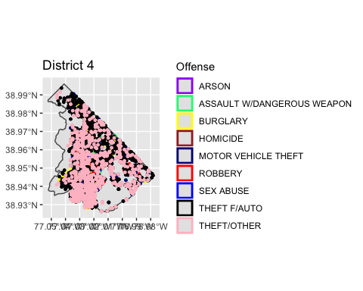
Crime incidence in each district
Different types of crimes occurred in District 4, although THEFTS occurred the most. There was also several ASSAULTS WITH WEAPONS in this area.
Crimes are evenly distributed in District 3. THEFTS are also the most frequent crime types occurred in this area.

Slide 11
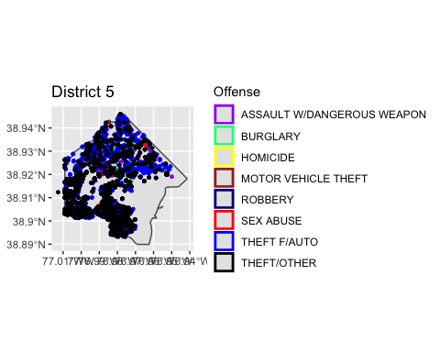
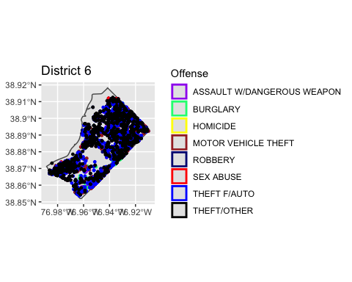
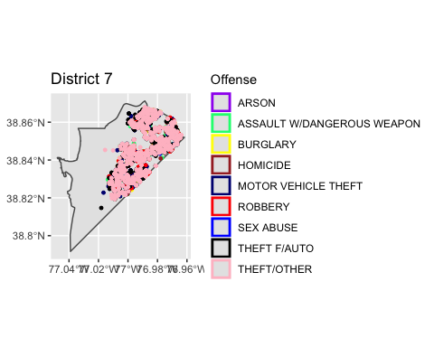
Crime incidence in each district
Most crimes occurred in southwest and north area of District 5
Crimes prevailed in the northeast area. THEFTS occurred the most, and ASSAULTS WITH WEAPON also happened frequently in the area.
Prevalence of theft and auto theft

Slide 12
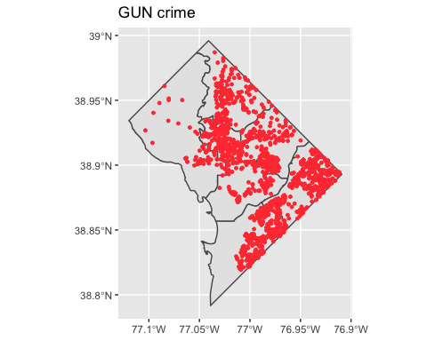
Where are the gun crimes taking place?
From the map, we can see most gun crimes are distributed in the east area of DC. It is obvious that crimes with gun occurred least in district 2.

Slide 13
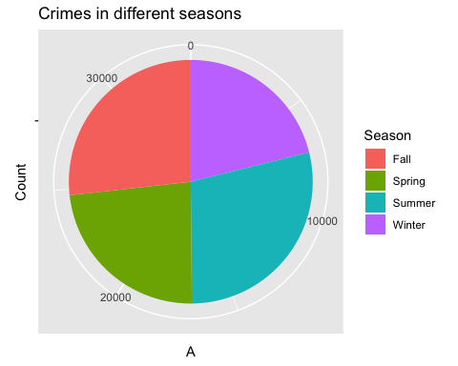
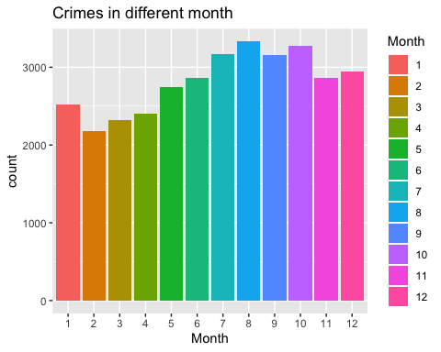
RELATIONSHIP BETWEEN TIME OF THE YEAR AND CRIME INCIDENCE
Crime incidence was higher in summer and fall
Highest in August, lowest in February

Slide 14
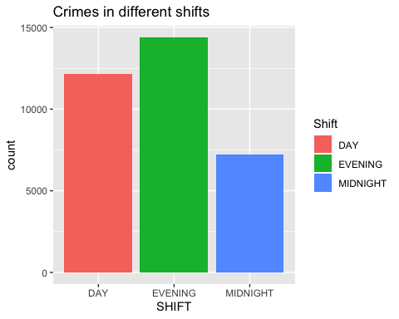
IS THERE A RELATIONSHIP BETWEEN CRIME AND TIME OF THE DAY?

Slide 15
IS THERE A RELATIONSHIP BETWEEN CRIME AND SEASONS OF THE YEAR?
Null hypothesis – There is no relationship between offense and season of the year
Alternative Hypothesis - There is a relationship between offense and season of the year
Chi-squared stat - 154.27
P- value - 2.2e-16
Decision - The p value is less than the level of statistical significance so we reject the null hypothesis that there is no relationship between offense and season of the year

Slide 16
IS THERE A RELATIONSHIP BETWEEN THE OFFENSE AND time of the day?
Null hypothesis - There is no relationship between offense and time of the day
Alternative Hypothesis - There is a relationship between offense and time of the day
Chi-squared stat - 2245.6
P- value - 2.2e-16
Decision - The p value is less than the level of statistical significance so we reject the null hypothesis that there is no relationship between offense and time of the day

Slide 17
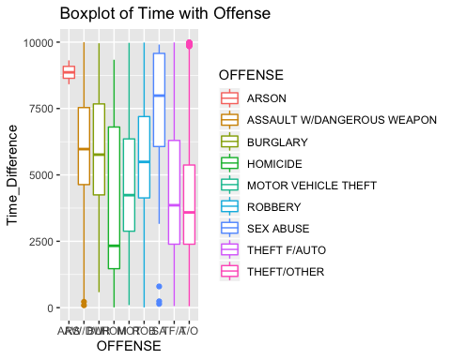
Does time difference between the crime date and the REPORT DATE vary according to offense?
The time difference between date of crime and reported date is highest for sex abuse. This can be due to the fact that victims of sexual abuse often feel shame and stigma and may need courage and time before reporting the incidence

Slide 18
Can we statistically prove that there is a relationship between time difference and Offense?
Null Hypothesis - The mean value of the time difference is the same across offense.
Alternative Hypothesis: The time difference varies across offense
P-value for Anova test: 2e-16
Decision – reject the null hypothesis
* We conducted a TurkeyHSD test but do not present it here because the variables are numerous

Slide 19
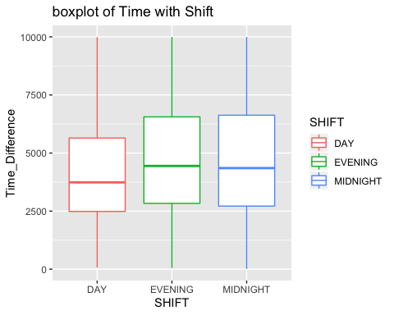
Does the time of the day an offense occurs determine the time it is reported?
Crimes that occur during the day are reported faster than crimes that occur in the evening and at midnight

Slide 20
Can we statistically prove THIS?
Null Hypothesis - The mean value of the time difference is the same across offense.
Alternative Hypothesis: The time difference varies across offense
P-value for Anova test: 2e-16
Decision – reject the null hypothesis
Further Action: Conducted TurkeyHSD
Result: For midnight and evening, the p-value is 0.67 which is larger than 0.05, we fail to reject the null hypothesis which implies that the mean time difference between midnight and evening shifts are the same

Slide 21
FINDINGS AND LIMITATIONS
In 2018, theft was the most common crime in metro DC
Crime occurred the most in August and in the summer
The difference between the time the offense occurred and the time it was reported varies according to crime types, the time difference is highest for sexual assault
Limitations - Most of variables in this dataset are categorical or discrete not continuous, insufficient data about the population, so we could only use crime frequency instead of crime rate
Further research – we will include other economic factors such as housing prices, unemployment, population, etc to further understand the drivers of crime rate in DC

Slide 22
WORK DIVISIONs
Ruth Akor: Introduction, Powerpoint
Kaiqi Yu, Zichu Chen: Code
Qing Ruan, Zixuan Huang: Results description and conclusion

Slide 23

ANY QUESTIONS?
THANK YOU!

